Slide 1

ECE 445 Group 1
December 2, 2011
George Karavaev – Alex Suchko

Slide 2
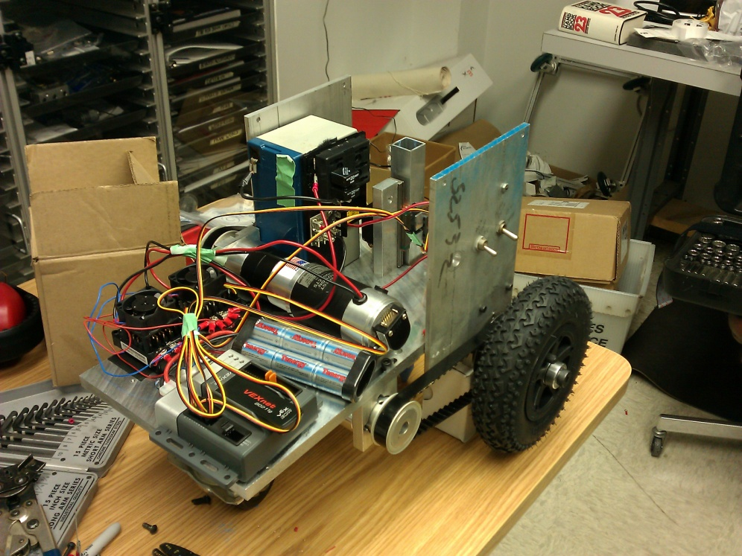
Introduction
ChalkBot is a semi-autonomous chalk drawing system.
Produces vector graphics.
Uses common, off the shelf sidewalk chalk.
Large project, divided into three sections:
Mechanics
Electronics
Software
Notes:
Focused on electronics for this semester, some software developed for testing and evaluation purposes.

Slide 3
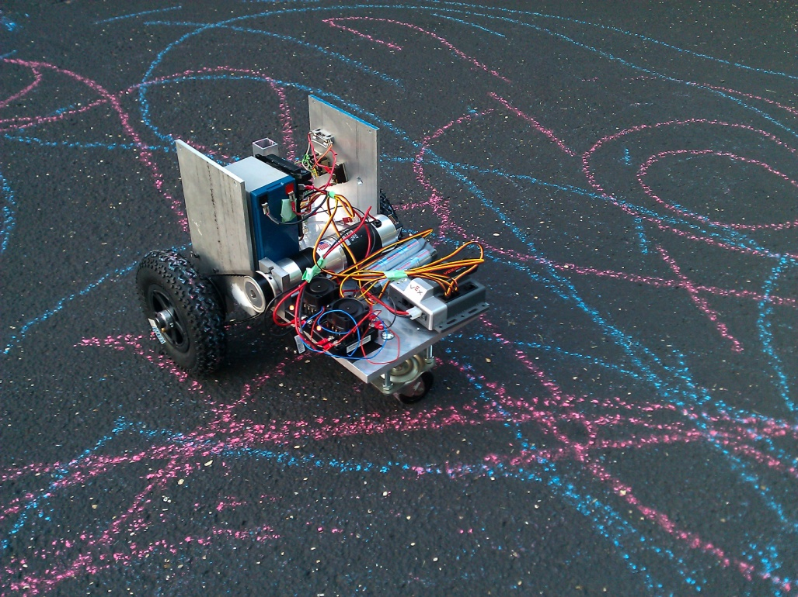
Outline
Mechanical Platform
GoBot Base and Chalk Feed
Electronics System
Overview
Dynamics Control Subsystem
Power Supply Subsystem
Carrier Board
High Level Control
Software
Power Monitor
Motion+Body Control
High Level Control
Summary

Slide 4
Mechanical Platform

Slide 5
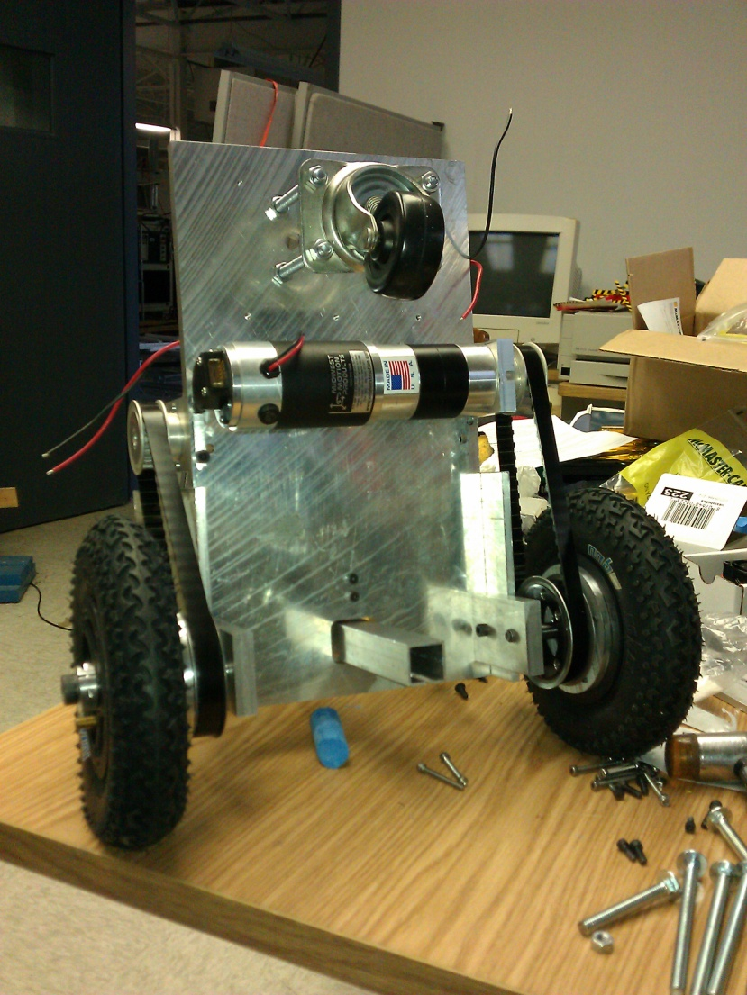
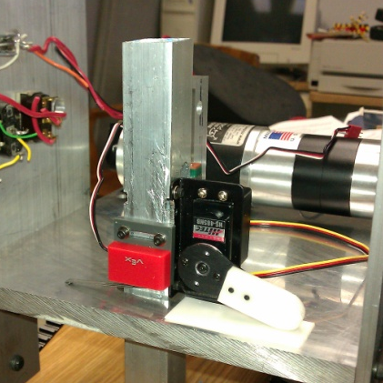
Mechanical Platform\\ GoBot Base and Chalk Feed
Two brushed drive motors, coupled to rear drive tires via synchronous belt.
Forward idler ‘caster’ wheel.
Rear mounted chalk feed mechanism, actuated by two positioning servo-motors.
One 12VDC nominal sealed lead-acid battery.
Notes:
Mention initial 24v system.

Slide 6
Electronics System

Slide 7
Electronics System\\ Overview

Slide 8
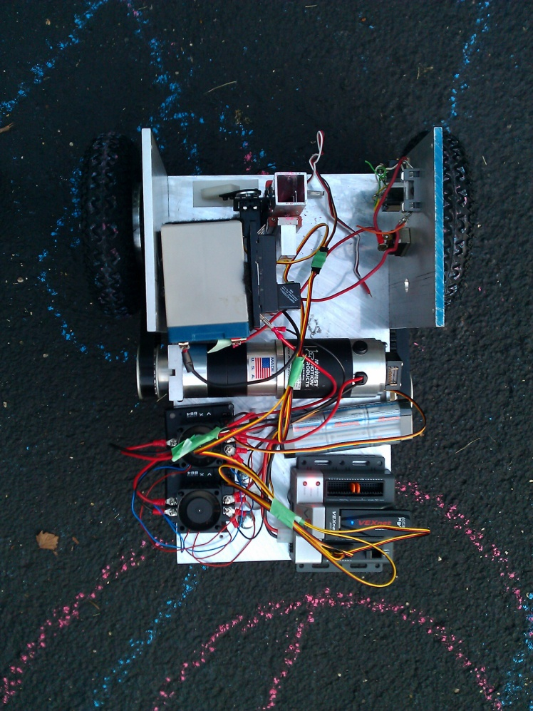
Electronics System\\ Outline
Dynamics Control Subsystem
H-Bridge Intro
F_{SW}
H-Bridge Realization
Motion+Body Controller
Power Supply Subsystem
Switchmode Supply
Power monitor
Carrier Board
Motion+Body Controller
Power monitor
High Level Control
Notes:
Torque ripple: Sufficient coupled inertia (picture, hub and tire rotational inertia coupled to motor)

Slide 9
Electronics System\\ Dynamics Control\H-Bridge Intro
Brushed DC Motor Control
2+ quadrant control
H-Bridge architecture
Concerns:
Inductive Flyback
High-Side Drive for n-type power MOSFETs.
Heating
Notes:
Quandrants of control: Torque-Speed curve quadrants (I: producing power forward, II: absorbing power backwards, III: producing power backwards, IV: absorbing power forwards), want I and III, producing power forwards and backwards

Slide 10
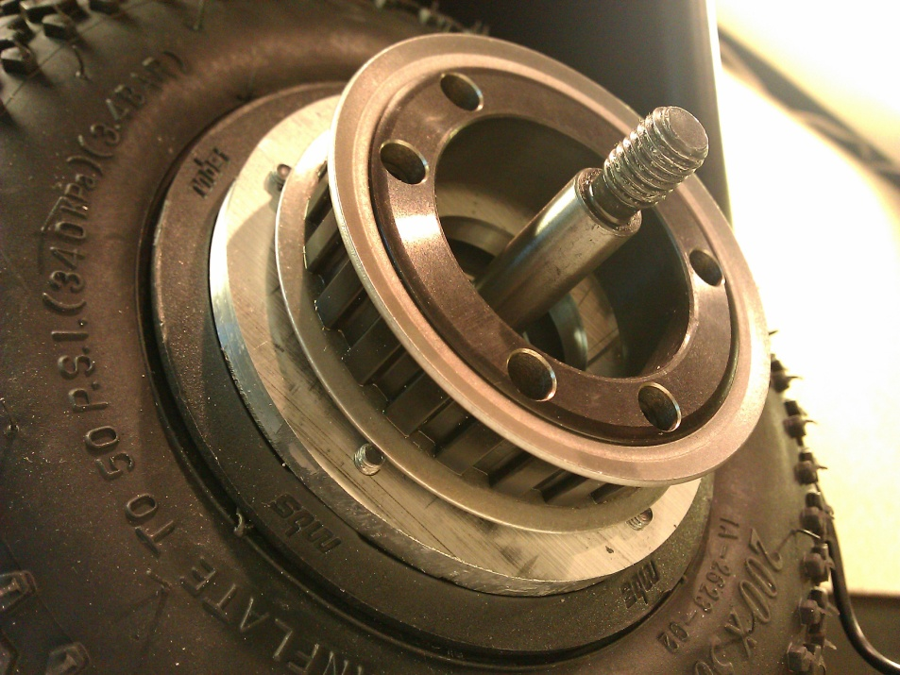
Electronics System\\ Dynamics Control\F_{SW}
F_{SW} selection
RL Current saturation
Torque ripple
Electro-mechanical coil noise
Heating
τ_{winding} = R_{winding} L_{winding}
≈ 0.94ms
Notes:
Torque ripple: Sufficient coupled inertia (picture, hub and tire rotational inertia coupled to motor)
Noise here is literally audible noise.

Slide 11
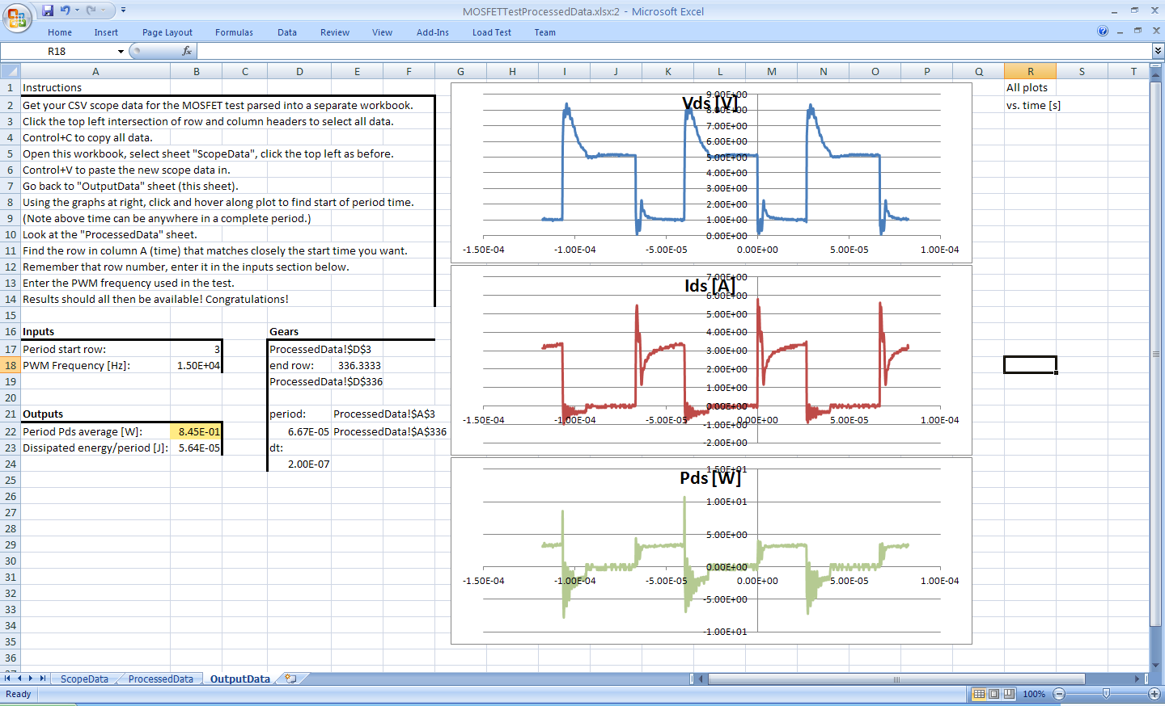
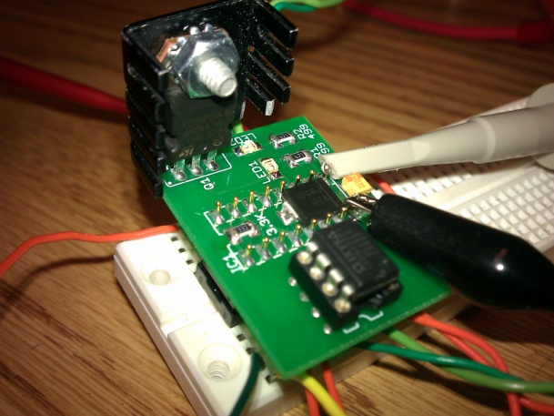
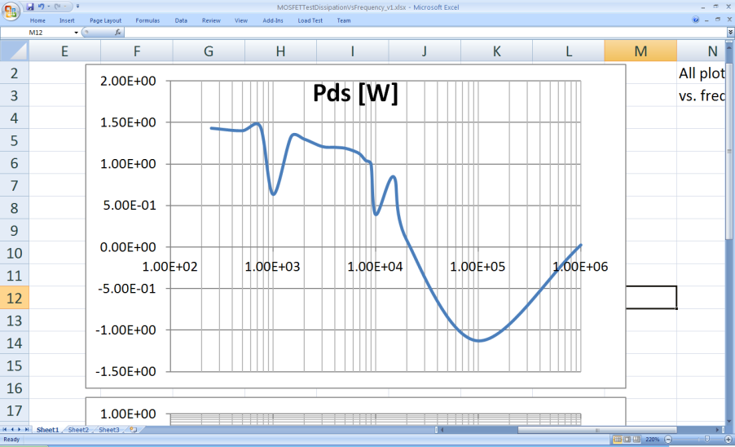
Electronics System\\ Dynamics Control\F_{SW}
F_{SW}≈15kHz
Heating tests with ECE-110 1-quadrant motor drive
Inductive load resistor
Qualitative results
Notes:
Point out nonsensical negative dip in Pds vs Fsw

Slide 12
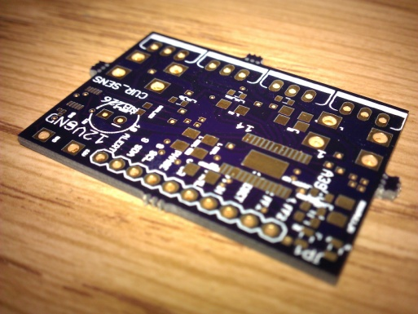
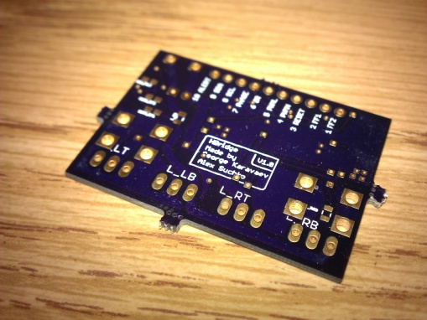
Electronics System\\ Dynamics Control\H-Bridge Realization 1
Allegro A3941
All N-FET power bridge
Synchronous and Body Diode rectification only
Signal reference via power ground
Notes:
Point out nonsensical negative dip in Pds vs Fsw

Slide 13
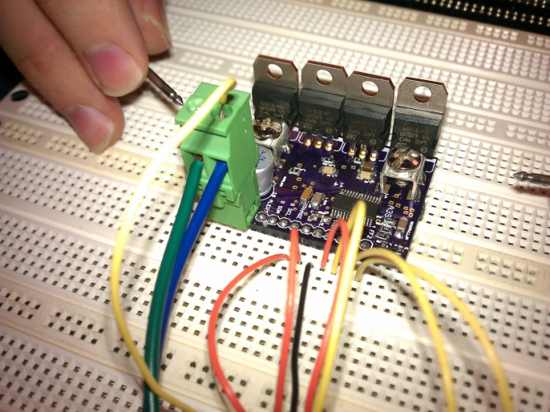
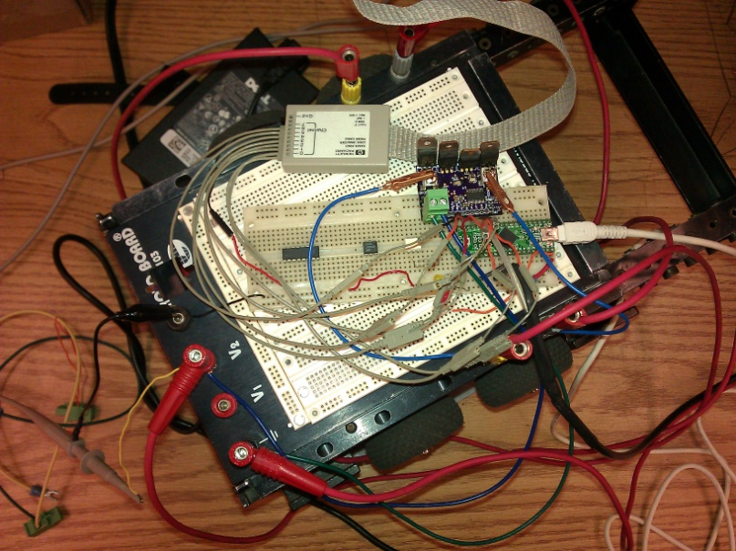
Electronics System\\ Dynamics Control\H-Bridge Realization 1
Positives
Functional, cool operation
Issues
Excessive signal reference movement
High frequency winding ‘ringing’ (LC oscillation)
Noise on input signals…
Notes:
Next slide for scope trace detailing noise following falling edge on PWMH.

Slide 14
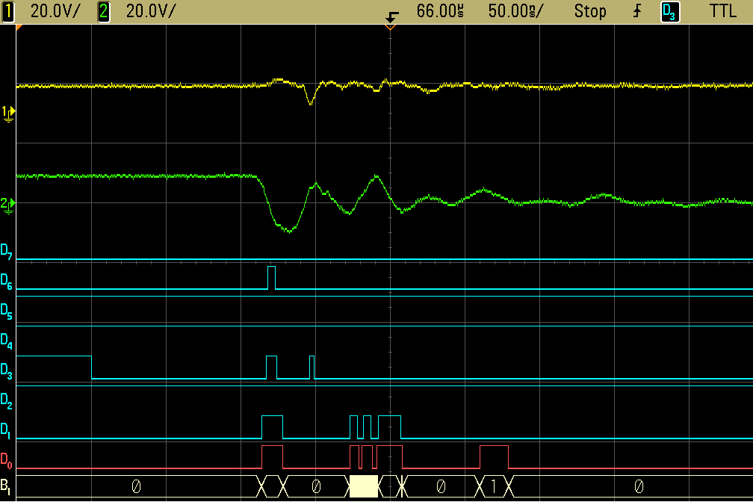
Electronics System\\ Dynamics Control\H-Bridge Realization 1
Signal Legend
1 | B+
2 | M+
D₀ | FF1
D₁ | FF2
D₂ | Reset
D₃ | PWMH
D₄ | PWML
D₅ | SR
D₆ | Phase
Notes:
Note undesired edges after PWMH falls as motor gates off.

Slide 15
Electronics System\\ Dynamics Control\H-Bridge Realization 2
‘Separate’ power and logic grounds.
N-FET support circuitry
R_{G} slew rate control
C_{DS} reduce ring frequency
External DS diode rectification supplement
Notes:
Separate power and logic ground paths.

Slide 16
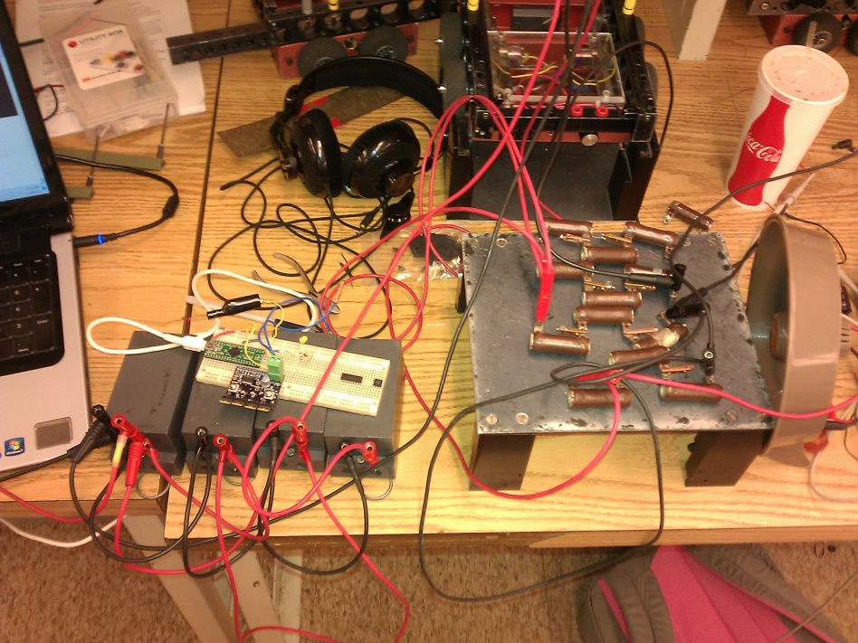
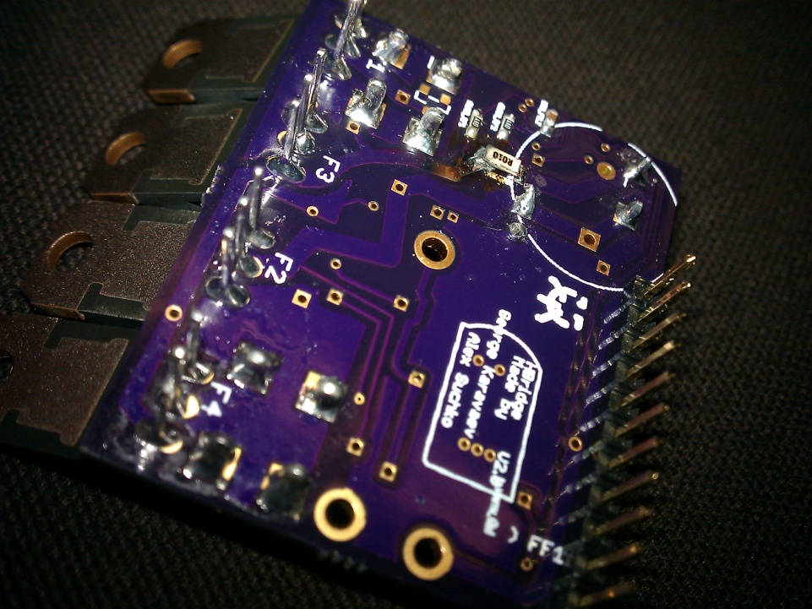
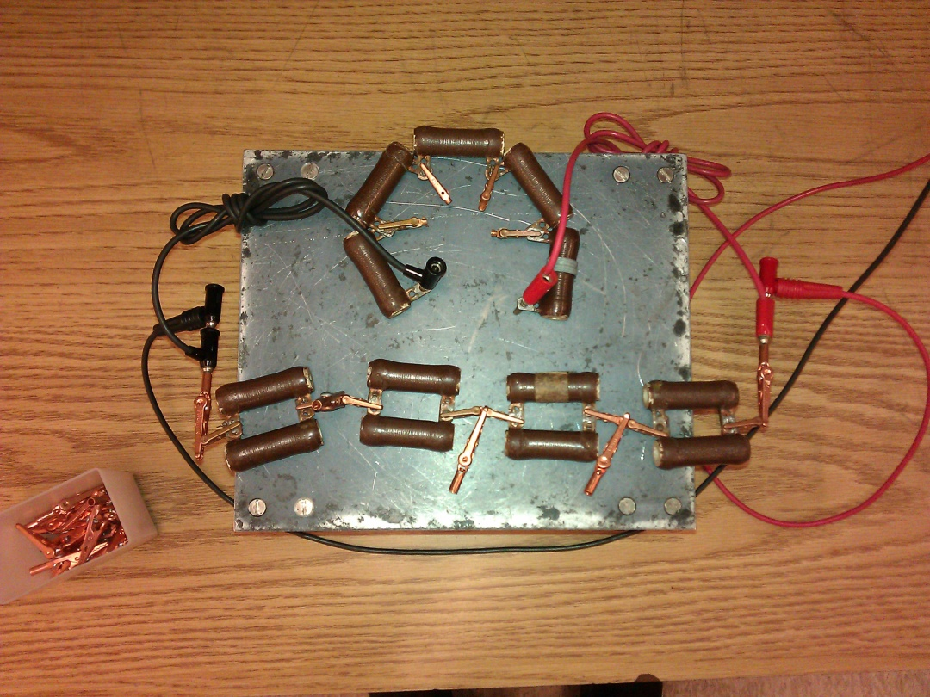
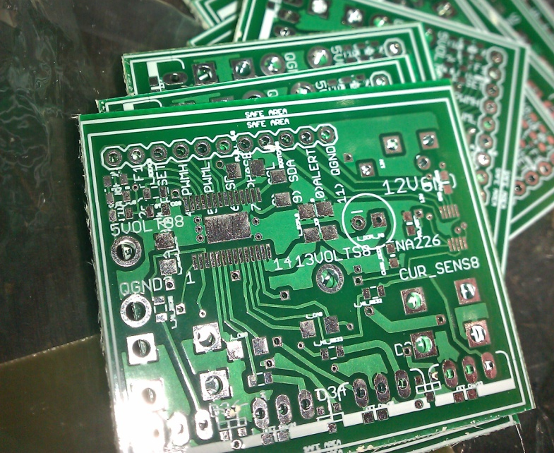
Electronics System\\ Dynamics Control\H-Bridge Realization 2
Late PCB arrival
Assembled, but little test time.
Notes:
Separate power and logic ground paths.

Slide 17
Electronics System\\ Dynamics Control\H-Bridge Realization 3
Backup in light of Realization 2 PCB delay
Highly integrated Allegro A3941 difficult to debug
Mixed P and N FET power bridge topology
Use of high side P-FETs enables use of ‘low-side’ drives for high side use
No need for integrated charge pump/bootstrap voltage boost controller
Notes:
Separate power and logic ground paths.

Slide 18
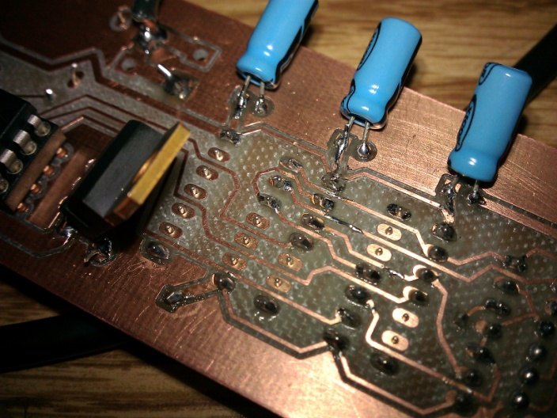
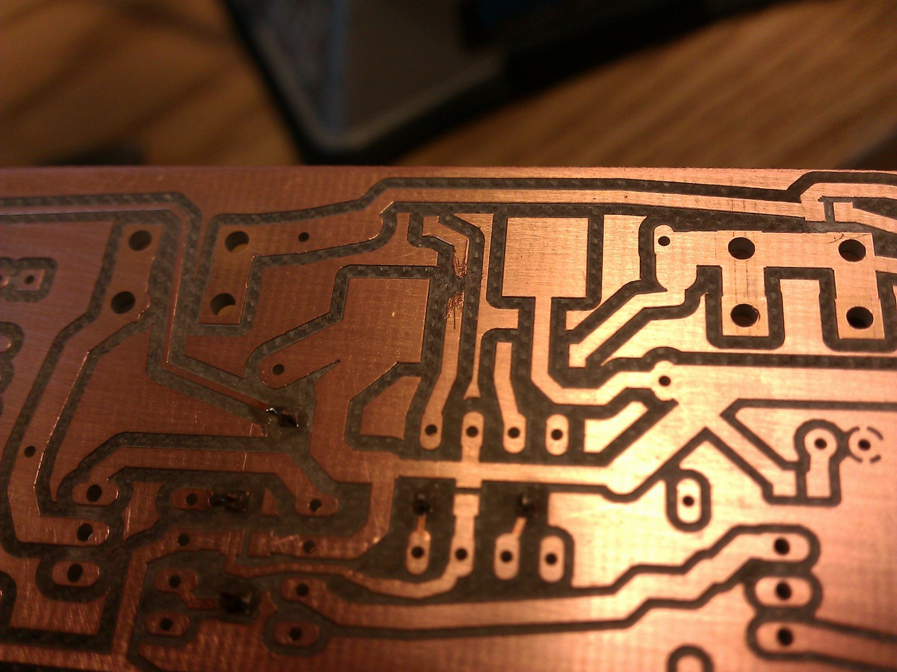
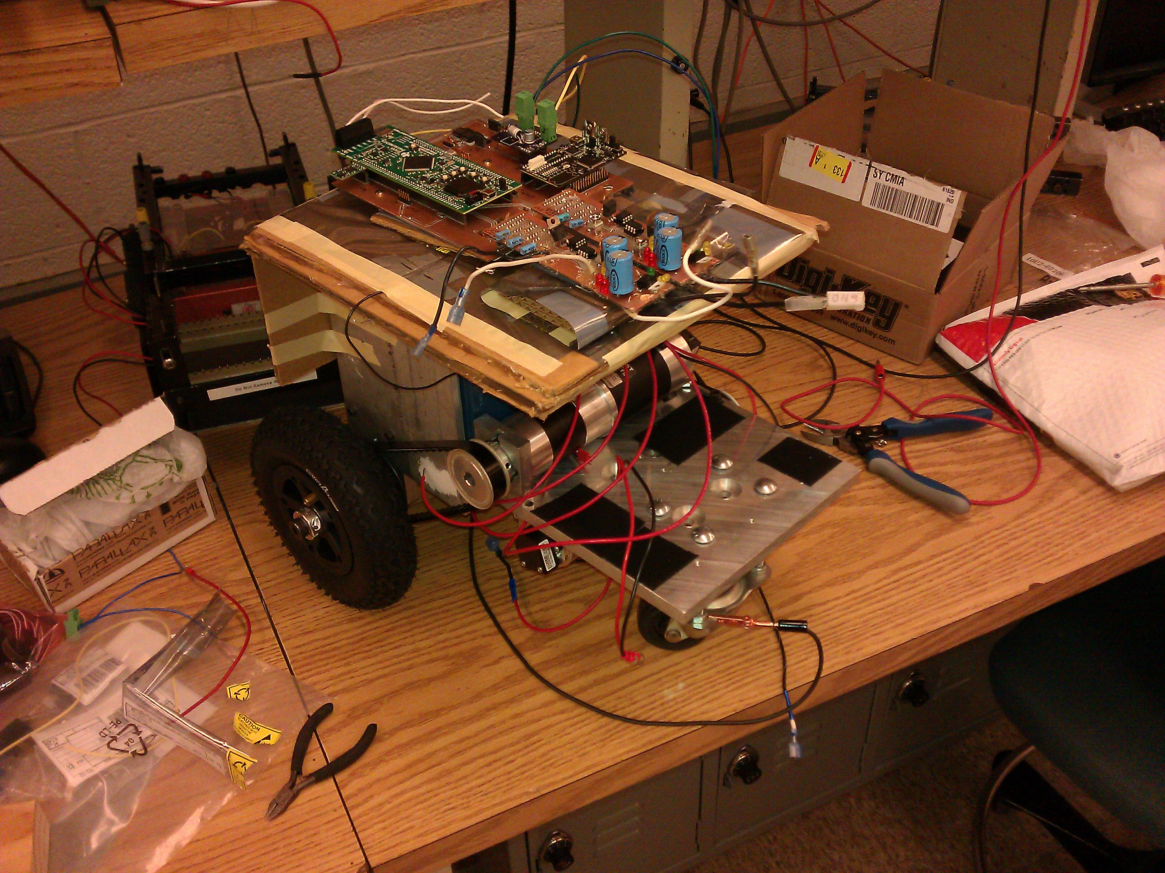
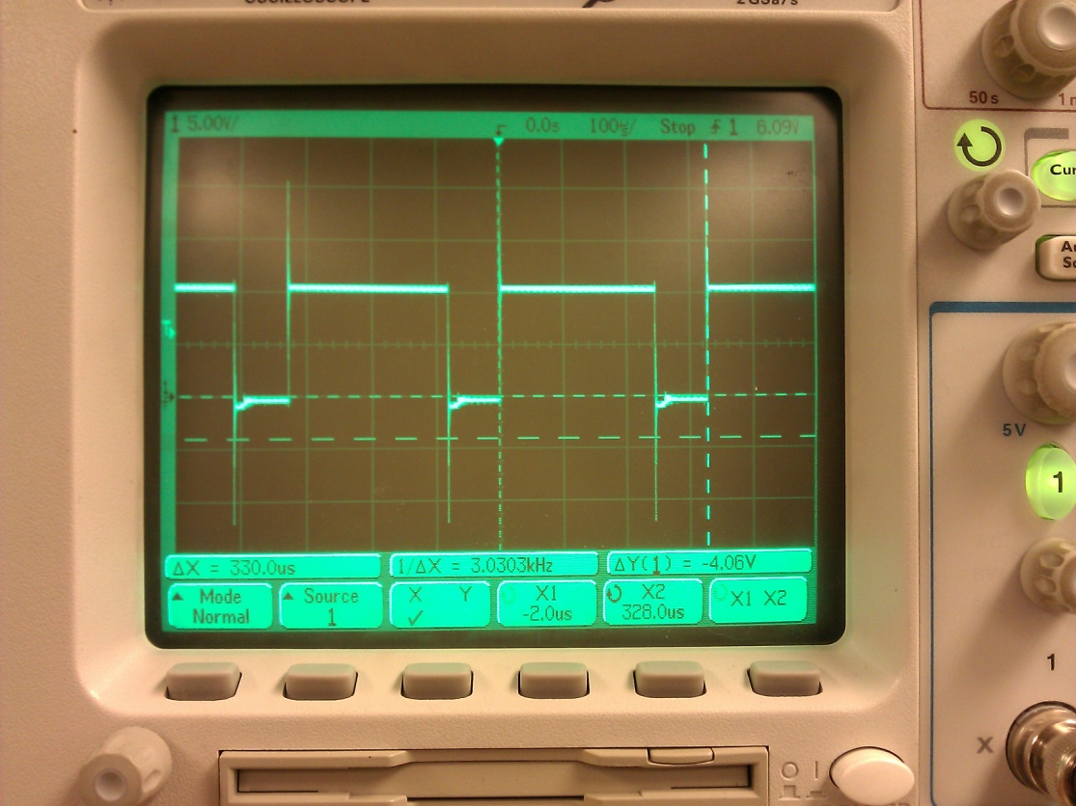
Electronics System\\ Dynamics Control\H-Bridge Realization 3
Evaluated using drive motors on ChalkBot.
P-FET high side significantly less efficient
Notes:
Scope trace shows positive side of load

Slide 19
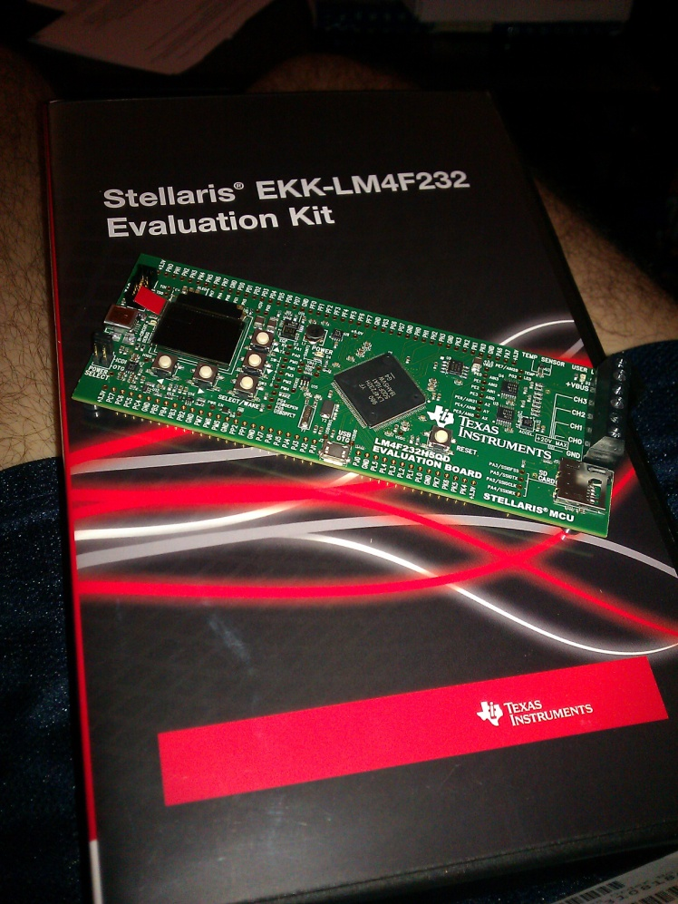
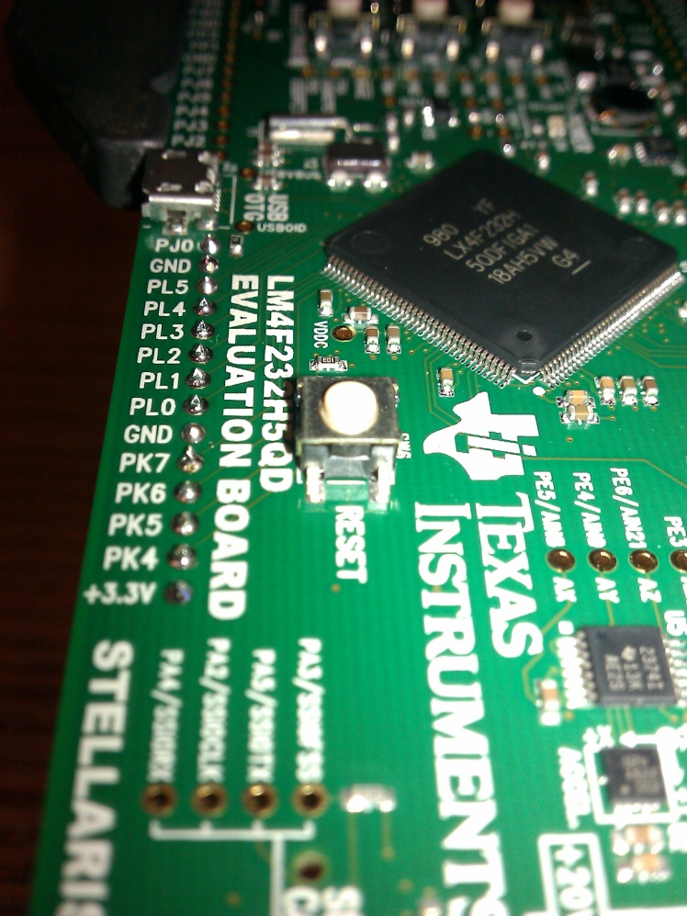
Electronics System\\ Dynamics Control\Motion+Body Control
Late change to LM4F232H5QD
Exceeds all hardware requirements
3.3v logic
USBH/D/OTG
A1 revision
Peripheral Type | Channels Required
GPIO | 17
ADC | 2
PWM | 4
Quadrature Encoder Interface (QEI) | 2
Input Capture | 4
I²C | 2
USB | 1
Notes:
Separate power and logic ground paths.

Slide 20
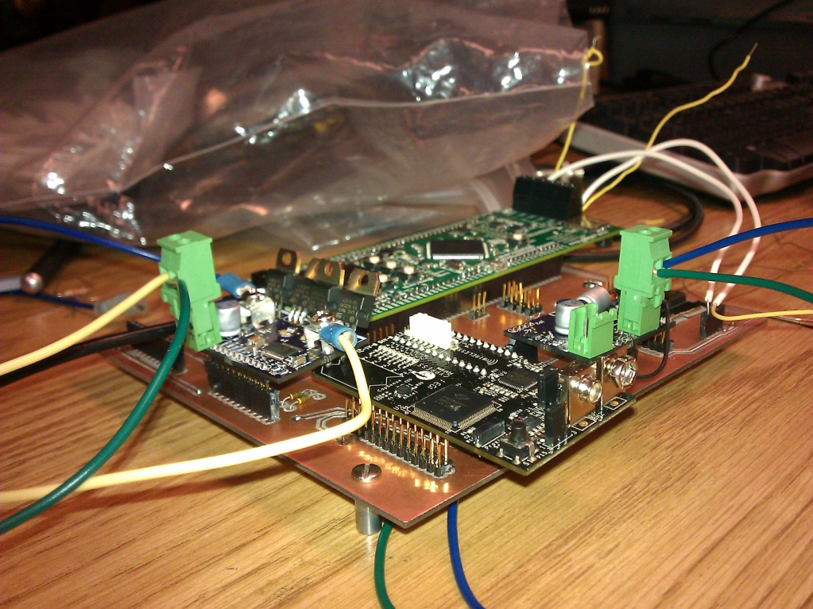

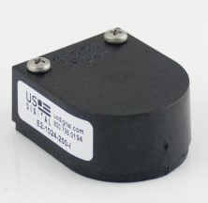
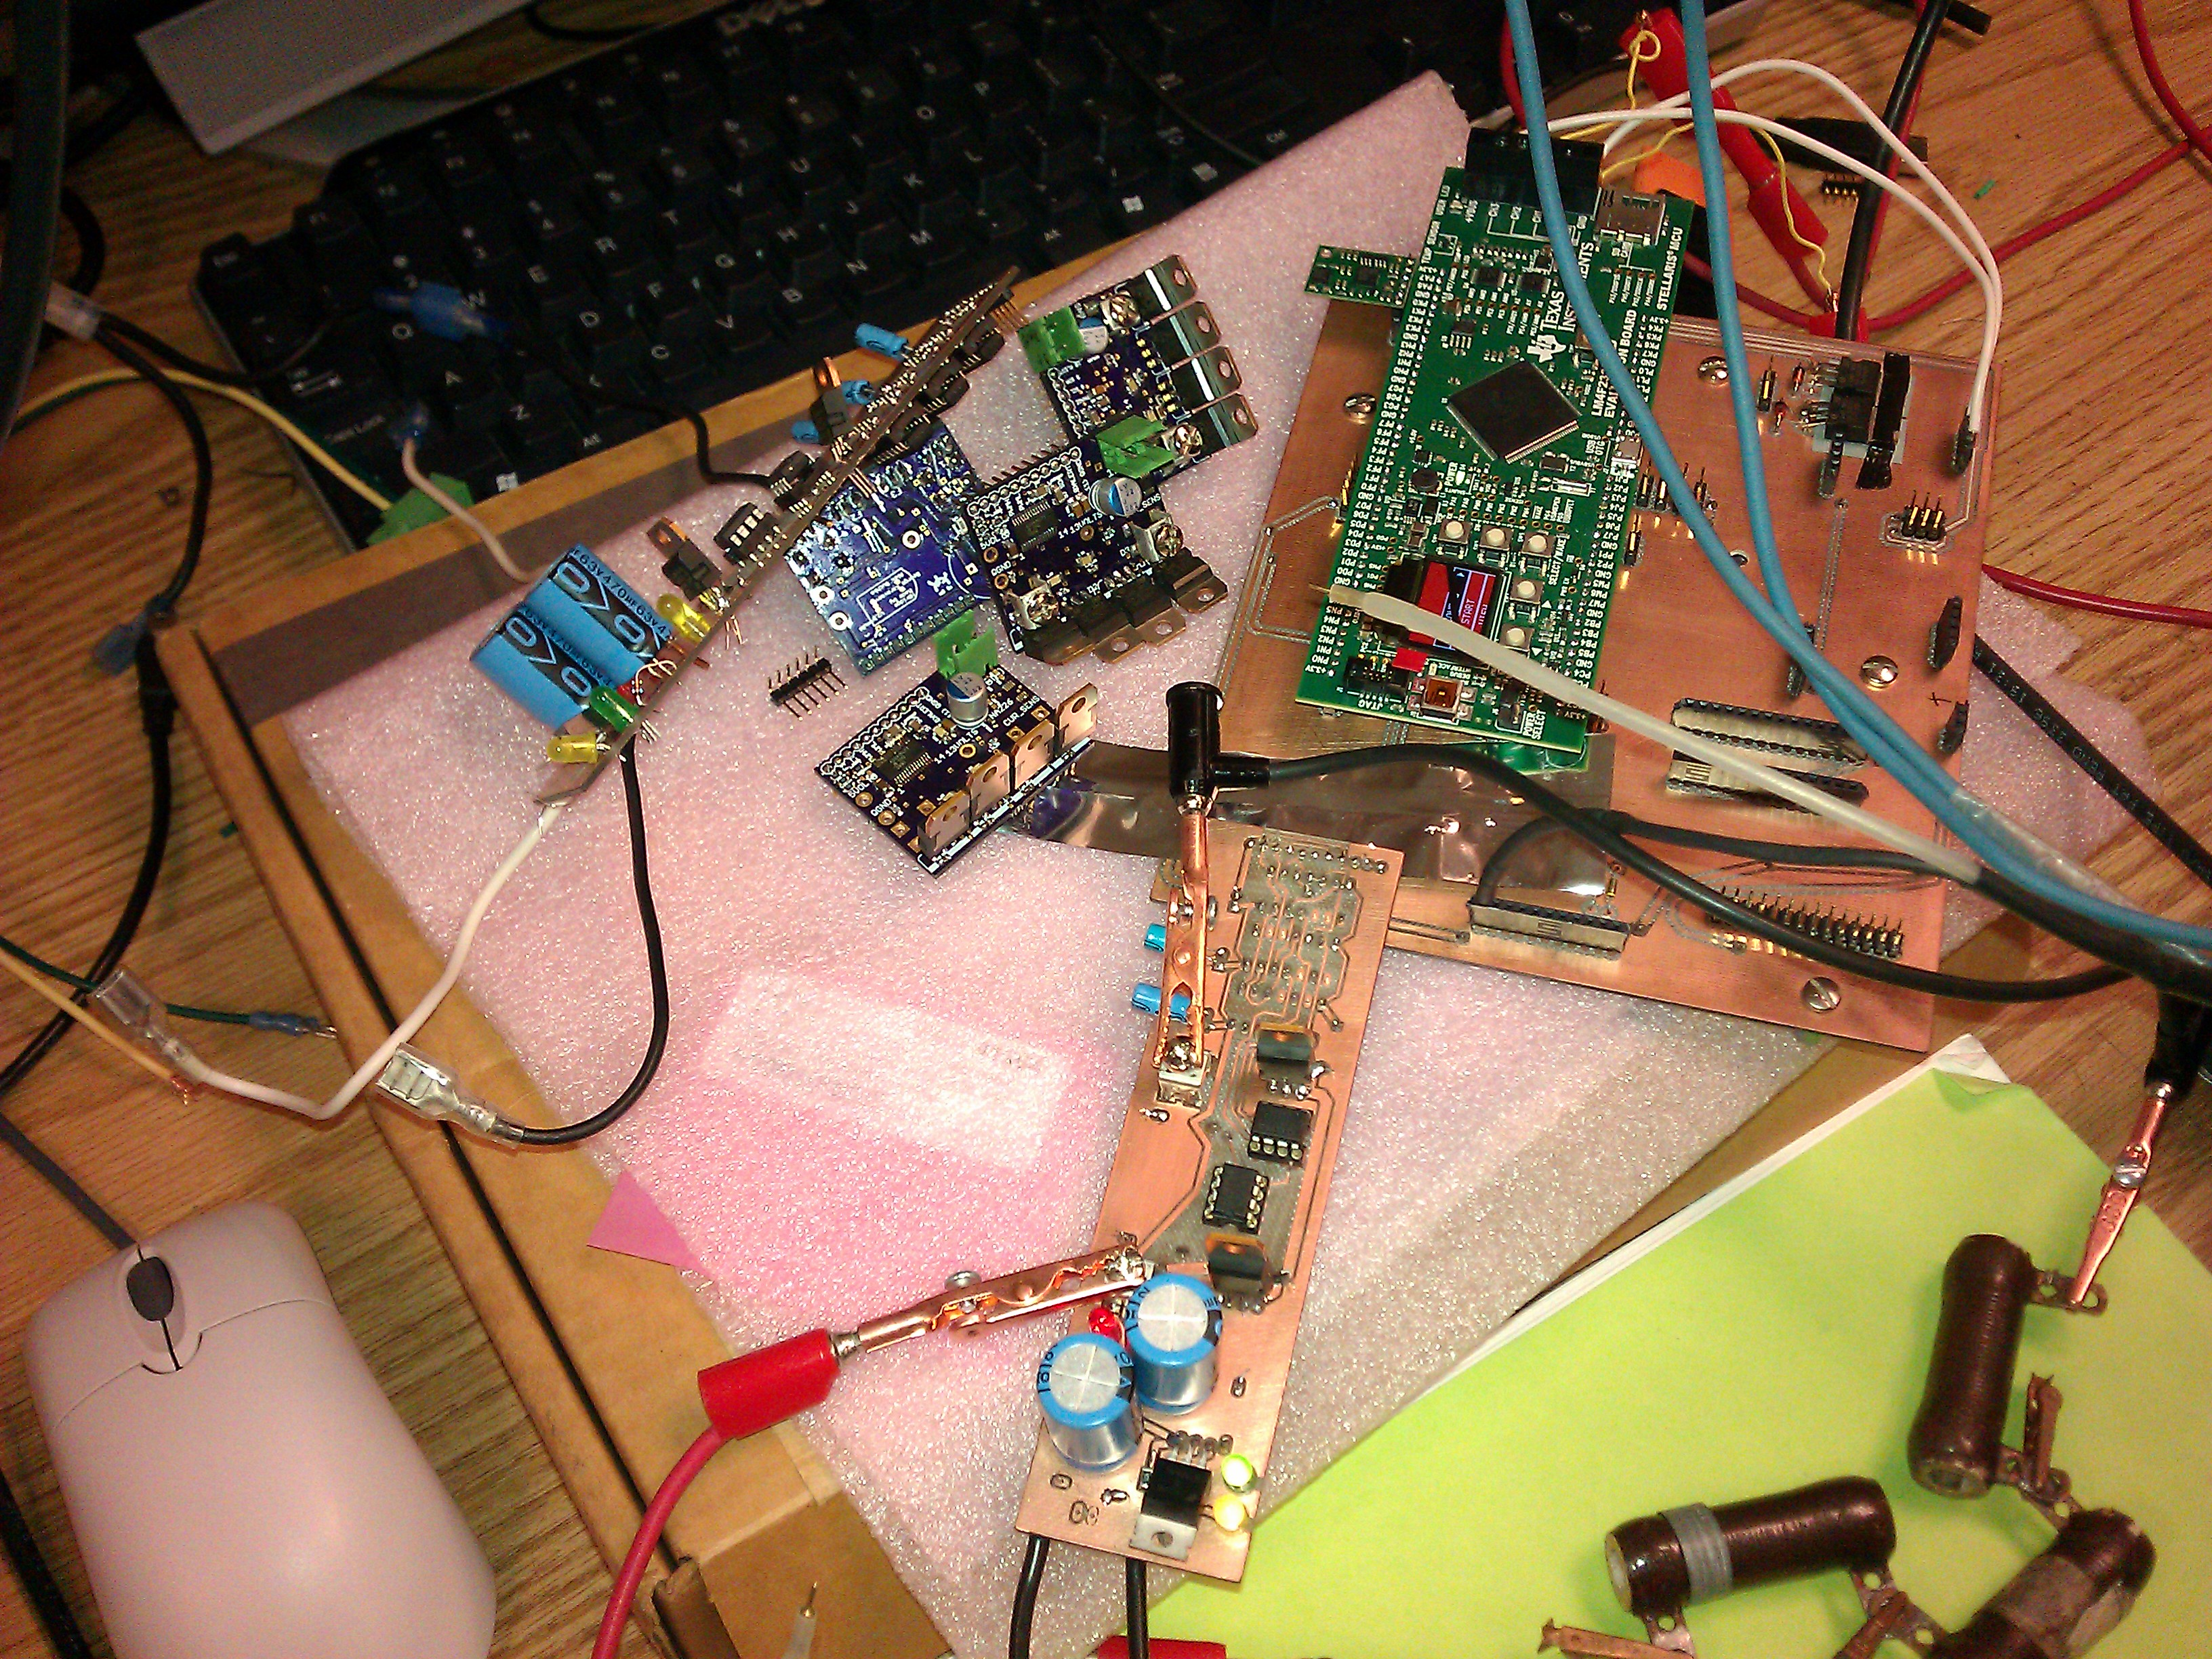
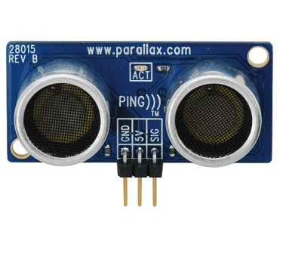
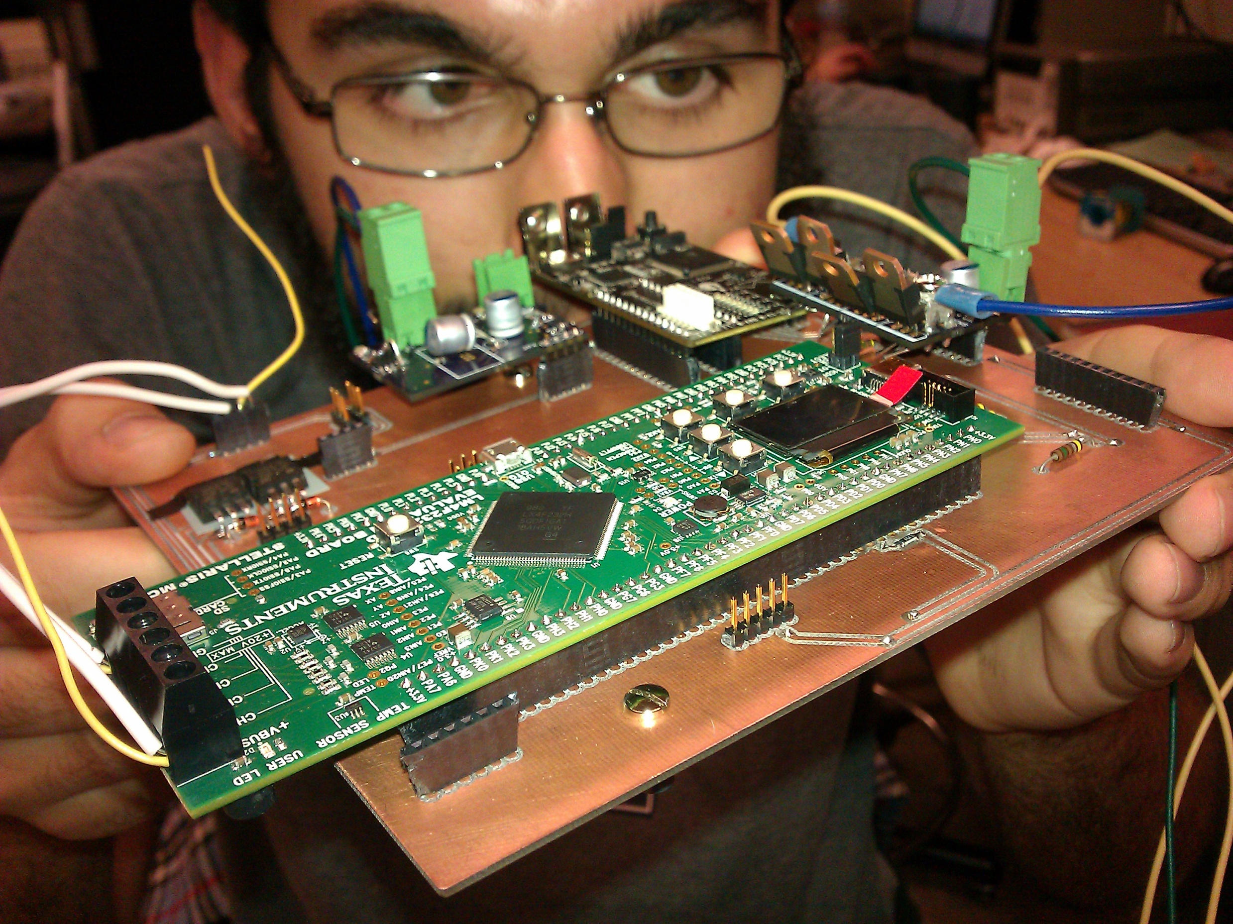



Electronics System\\ Dynamics Control\Motion+Body Control
Application Funcitons
Drive motor control
Servo-motor control
Quadrature Encoder Interface (QEI)
Inertial Measurement Unit (IMU) Interface
Ultrasonic Sensor Interface
Accessory Drive
Chalk Mechanism Automation
Feedback Motion Control
USB Communications to Pandaboard
US Digital
Parallax, Inc.
Notes:
For brevity, these will be discussed verbally.

Slide 21
Electronics System\\ Power Supply Subsystem\Switchmode Supply
Regulated (5V) power consumers
Servo-motors
Pandaboard
LM4F board
Carrier board
Load handled by two independent switchmode supplies.
Controller selection: On Semiconductor NCP3155A
Notes:
Consumers are in order of descending consumption

Slide 22
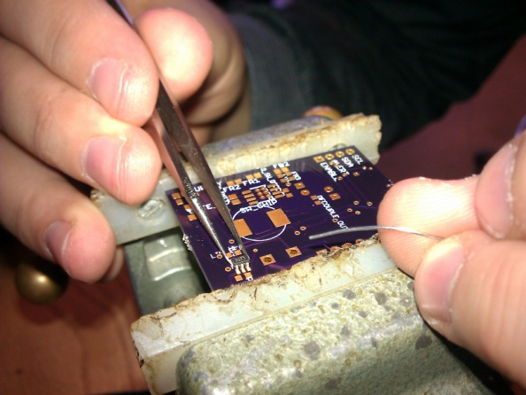
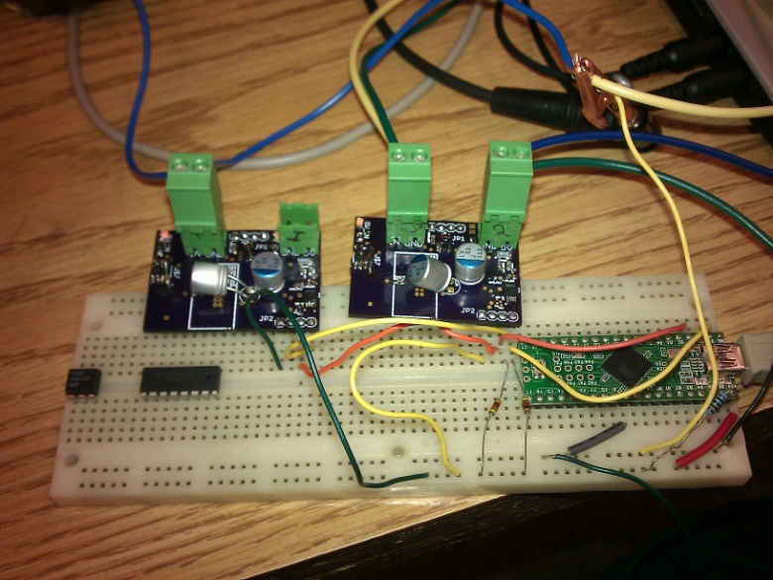
Electronics System\\ Power Supply Subsystem\Switchmode Supply
Design Parameters
V_{IN} | 9v-16v, nom. 12v
V_{OUT} | 5v
V_{IN_RIPPLE} | 300mV
V_{OUT_RIPPLE} | 50mV
I_{OUT} | 1.5A
F_{SW} | 500kHz
Reasoning for selection
Efficiency
Low external part count
High power capability
Moderate switching frequency
Additional Board Features
High side enable switch
Temperature Sensing
Power monitoring (TI INA226)
Values as built
General | C_{OUT} | 22μF
 | C_{IN} | 22μF
 | L_{OUT} | 22μH
 | R_{SET} | ∞Ω
 | C_{BST} | 0.1μF
Compensation | C_{C1} | 165pF
 | R_{C1} | 178kΩ
 | C_{C2} | 3.6pF
Feedback Sense | R_{HIGH} | 19.6kΩ
 | R_{LOW} | 3.74kΩ
Notes:
Balance of LC filter component size (want higher frequency to shrink, less ripple) and heating (higher at higher Fsw).

Slide 23
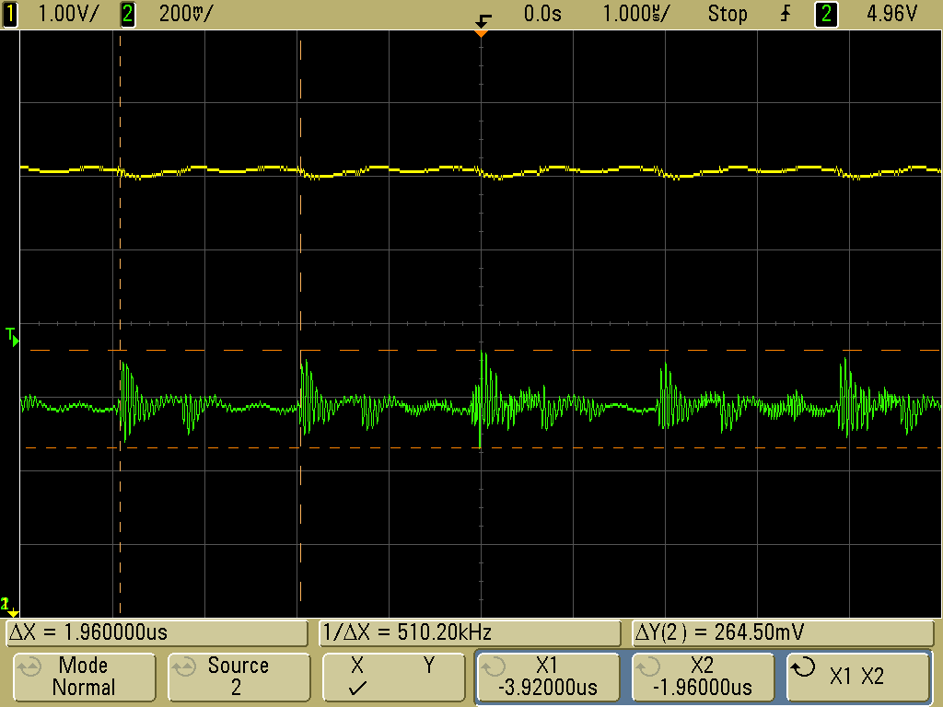
Electronics System\\ Power Supply Subsystem\Switchmode Supply
Ripple Test (scope)
P_{OUT} ≈ 6.9W
V_{PP_RIPPLE} ≈ 265mV,
F_{SW} ≈ 510.20kHz
Efficiency test data
Uses load resistance value for current calculation, possible inaccuracy.
Signal Legend
1 | V_{IN}
2 | V_{OUT}
Efficiency Test
Input | V_{IN} | 15V
 | I_{IN_AVG} | 0.438A
 | P_{IN_AVG} | 6.57W
Output | V_{OUT_APPROX} | 5V
 | I_{OUT_APPROX} | 1.25A
 | P_{OUT_APPROX} | 6.25W
Efficiency | P_{DISSIPATION_APPROX} | 0.32W
 | %_{EFFICIENCY} | 95%
Notes:
Note Rset infinity, disabled NCP3155A overcurrent sensing using DS junction of high side NFET, unpreliable behavior, INA226 with power switch to limit

Slide 24
Electronics System\\ Power Supply Subsystem\Switchmode Supply
INA226 (power sensor)
Shunt voltage monitoring tested to be within 1% of reading on Agilent MSO6012A.
Voltage droop
Additional 2.2μf ceramic output capacitance installed.
Idle: V_{OUT} ≈ 4.94V
I_{OUT} ≈ 1.2A, V_{OUT} ≈ 4.85V
Additional test results in tables at right.
Temperature Monitor Testing
Condition | Absolute Temp. | Temp. Rise over Amb.
Ambient | 21°C | 0°C
Supply Idle (no load) | 24°C | 3°C
IOUT = 1A | 28°C | 7°C
IOUT = 1.2A | 31°C | 11°C
Overcurrent alert via INA226
Item | Worst Case Time
Alert pin asserted by INA226 | 1.1ms
Alert pin detected by power monitor | 100ns
Power monitor shuts off high side switch | 12ms
Total time condition to shut off | 13.4ms
Notes:
Balance of LC filter component size (want higher frequency to shrink, less ripple) and heating (higher at higher Fsw).

Slide 25
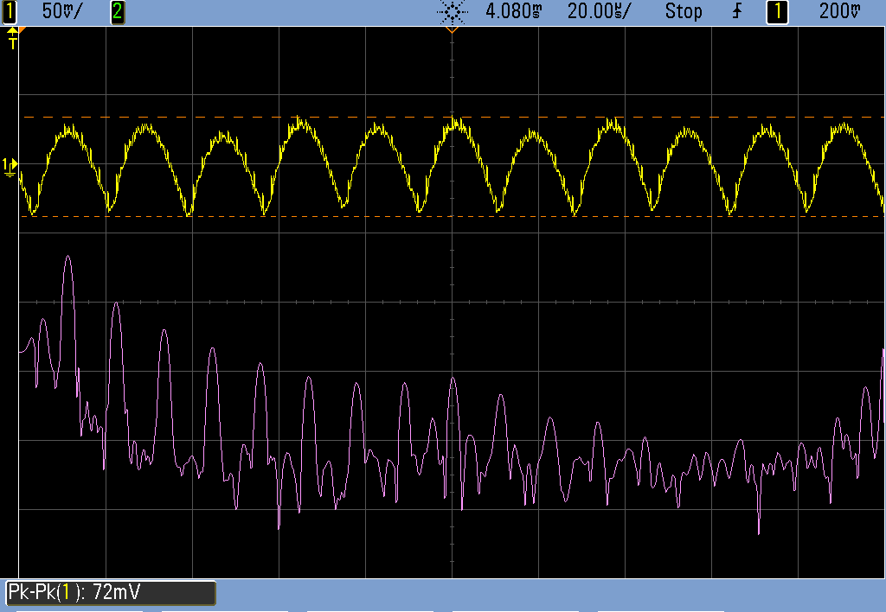
Electronics System\\ Power Supply Subsystem\Switchmode Supply
Ripple test with additional ceramic output capacitance.
C_{OUTC} ≈ 2.2μf
V_{IN} ≈ 10V, I_{IN} ≈ 466mA
Ripple meets performance expectations.
Signal Legend
1 | V_{OUT}
M | FFT
Notes:
Note Rset infinity, disabled NCP3155A overcurrent sensing using DS junction of high side NFET, unpreliable behavior, INA226 with power switch to limit

Slide 26
Electronics System\\ Power Supply Subsystem\Power Monitor
George
karavaev
Notes:
Balance of LC filter component size (want higher frequency to shrink, less ripple) and heating (higher at higher Fsw).

Slide 27
Electronics System\\ Carrier Board\Motion+Body Controller

Slide 28
Electronics System\\ Carrier Board\Power Monitor

Slide 29
Electronics System\\ High Level Control
George
karavaev
Notes:
Balance of LC filter component size (want higher frequency to shrink, less ripple) and heating (higher at higher Fsw).

Slide 30
Software

Slide 31
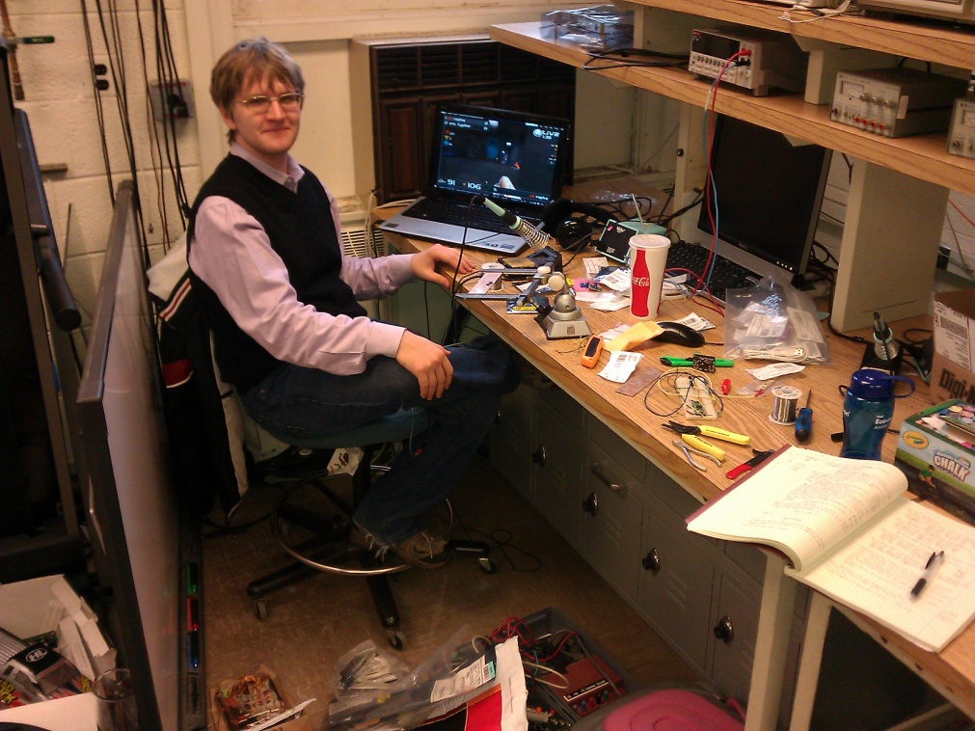
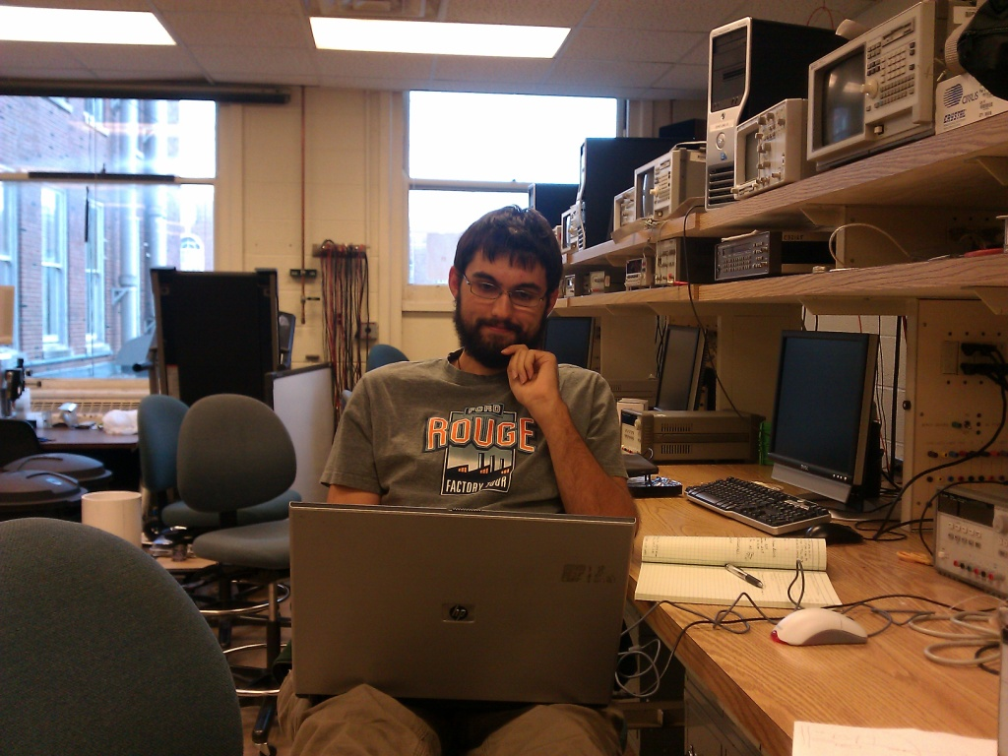
Software\\ Outline
Power Monitor (PSoC 5)
Motion+Body Control (LM4F)
High Level Control (Pandaboard)
Notes:
Torque ripple: Sufficient coupled inertia (picture, hub and tire rotational inertia coupled to motor)

Slide 32
Software\\ Power Monitor
Notes:
Torque ripple: Sufficient coupled inertia (picture, hub and tire rotational inertia coupled to motor)

Slide 33
Software\\ Motion+Body Control
H-Bridge
Uses hardware PWM unit
Also operates GPIO type control lines to H-bridge
Abstracts control lines and PWM to a hbr_set_effort function which takes a signed effort. Made to mate easily to a feedback control algorithm.
F_{SW} configurable at compile time.
Notes:
Torque ripple: Sufficient coupled inertia (picture, hub and tire rotational inertia coupled to motor)

Slide 34
Software\\ Motion+Body Control
Servo-Motor
Uses hardware PWM unit
Designed to interface with ‘radio control’ type positional servo-motors
Allows user to specify desired pulse width in μs or in clock ticks.
Provides optional 60Hz periodic interrupt.
Notes:
Torque ripple: Sufficient coupled inertia (picture, hub and tire rotational inertia coupled to motor)

Slide 35
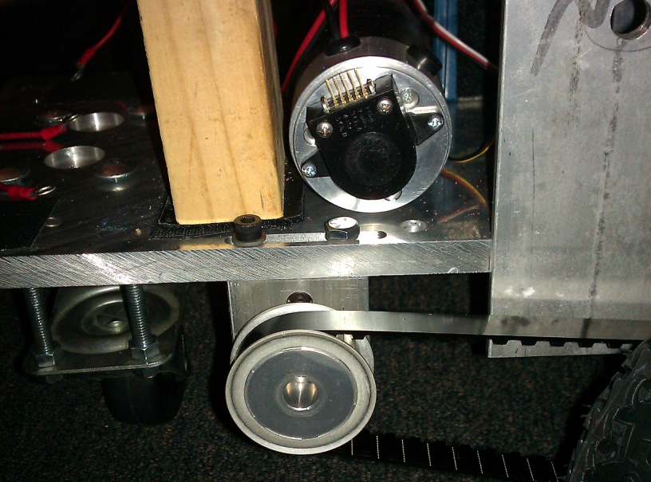
Software\\ Motion+Body Control
Encoder
Initializes and interfaces with quadrature encoder decode/integrate/derivative hardware on-chip.
4x counts per encoder line
Dual channel
Rollover configured to enable interpretation of count as a 32b 2’s complement value.
Encoder API applied to our ChalkBot (all figures approximate)
Translational range | 135km
Translational resolution | 63μm
Minimum nonzero detectable translational speed | 3.8mm/s
Maximum detectable translational speed | 1.63x10^7m/s
Translational velocity resolution | 3.8 (mm/s)/pulse/period
Notes:
Torque ripple: Sufficient coupled inertia (picture, hub and tire rotational inertia coupled to motor)

Slide 36

Software\\ Motion+Body Control
USB device
Implements USB CDC ACM
Implementation by TI, via StellarisWare.
Application level protocol: Implemented modified form of Modicon Modbus RTU protocol, considering the USB protocol environment.
Based on register transfers.
Notes:
Torque ripple: Sufficient coupled inertia (picture, hub and tire rotational inertia coupled to motor)

Slide 37
Software\\ Motion+Body Control
Change register 11₁₀ to 2048₁₀
0x10 | CBUS_FN_CODE_WRITE
0x00 | <pad byte>
0x0B | Start operating at register 11₁₀
0x00
0x01 | Read 1 register
0x00
0x04 | Payload byte count in this packet, here 4₁₀.
0x00
0x00 | Payload word (32b) zero, here 2048_{10.}
0x08
0x00
0x00
Slave response
0x10 | CBUS_FN_CODE_WRITE
0x00 | <pad byte>
0x0B | Start operating at register 11₁₀
0x00
0x01 | Read 1 register
0x00
0x00 | Payload byte count in this packet, here 0₁₀.
0x00
ChalkBus
32b register size
Read and Write register implemented.
Slave (LM4F) sends exception codes on error.
Example conversation at right.
Note, X₁₀ denotes a base 10 number.
Notes:
Torque ripple: Sufficient coupled inertia (picture, hub and tire rotational inertia coupled to motor)

Slide 38
Software\\ Motion+Body Control
Inertial Measurement Unit (IMU)
Uses software-emulated I²C communications, could not get I²C hardware to run properly on LM4F A1 revision.
Current implementation: Z-axis gyro interface
Available: XYZ Accel, Gyro, Mag.
State machine
I²C initialize
Gyro initialize
Zero rate point calibration
Integration of rate to estimate heading
‘Get’ functions
Notes:
I2C issues

Slide 39
Software\\ High Level Control
a
George
karavaev
Notes:
Torque ripple: Sufficient coupled inertia (picture, hub and tire rotational inertia coupled to motor)

Slide 40
Summary

Slide 41

Summary\\
ChalkBot is…
A project, whose goal is to develop a semi-autonomous robot capable of drawing vector graphics with common sidewalk chalk.
A differential-drive mobile robot, with a one-stick chalk feed mechanism.
Notes:
I2C issues

Slide 42
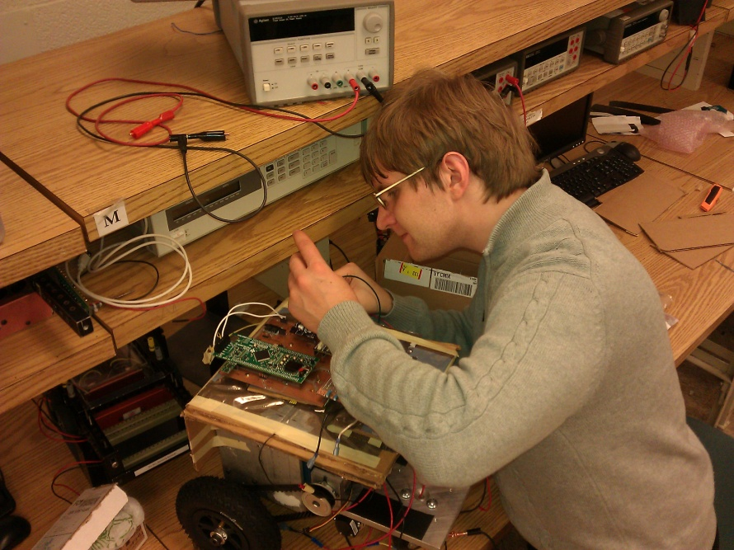
Summary\\
ChalkBot has…
Two H-bridge power MOSFET motor drives.
A motion and body function controller which,
controls the drive motors,
chalk mechanism,
reads sensors,
can communicate with the high level controller.
Notes:
I2C issues

Slide 43
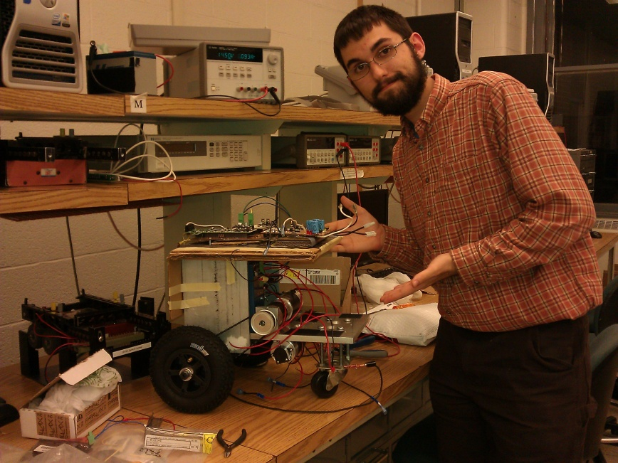
Summary\\
ChalkBot has…
A pair of high efficiency 12V nom. to 1.5A, 5V switchmode buck converters.
A power monitor to oversee the operation of the power supplies.
A carrier board which interfaces the
H-Bridges
Motion+Body Controller
Power Supplies
Sensors
A USB high level controller interface, to support directive control and computation-intensive automation.
Notes:
I2C issues

Slide 44
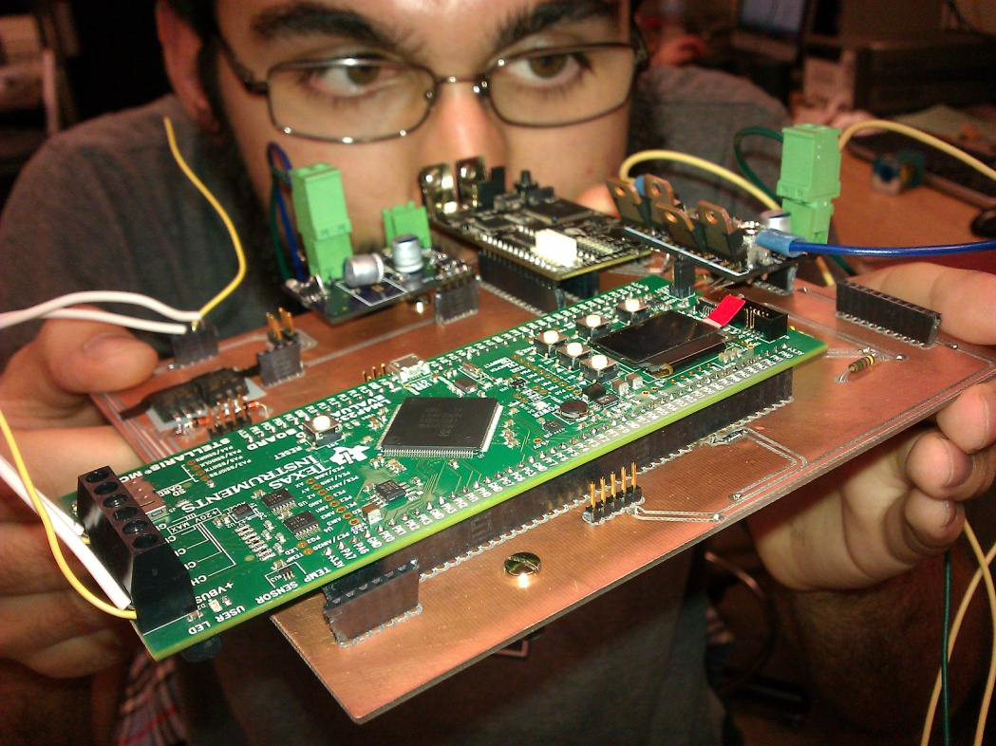
Summary\\
ChalkBot’s software enables…
Power supply monitoring
Drive motor control
‘Radio-control’ servo-motor control
Quadrature encoder interfacing
Easy to use and extensibel USB communication
Inertial heading estimation
Access to high level control functionality.
Notes:
I2C issues

Slide 45
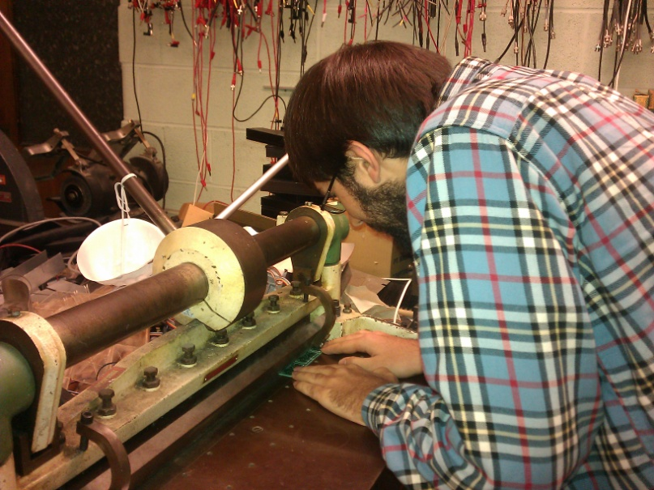
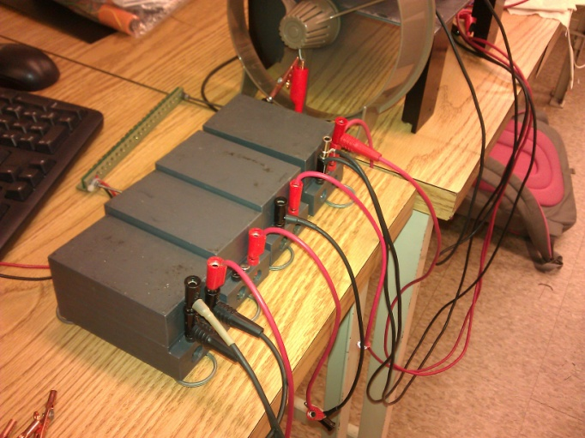
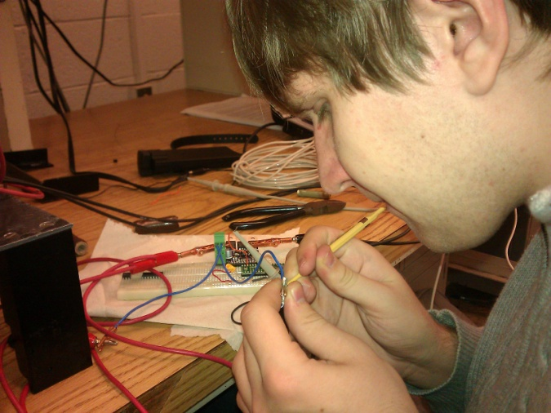
Summary\\ Ethics
No ChalkBotters or ChalkBottees were harmed…
Safety of situation was evaluated during tests with clear and present risk.
Safety of system was considered before making any public demonstrations.
Concerns were expressed freely and openly.
Ultrasonic range-finding support was designed for ChalkBot operation in public.
Notes:
I2C issues

Slide 46

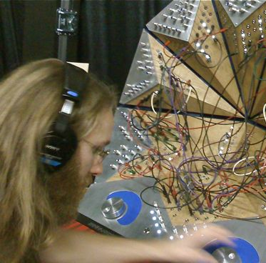

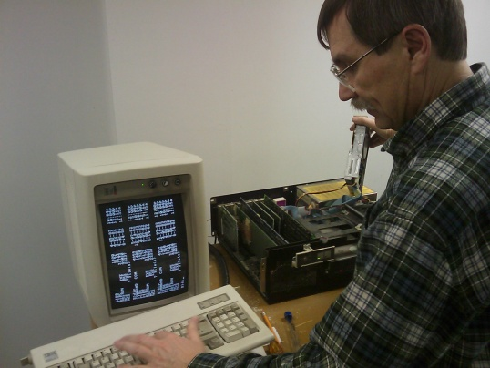
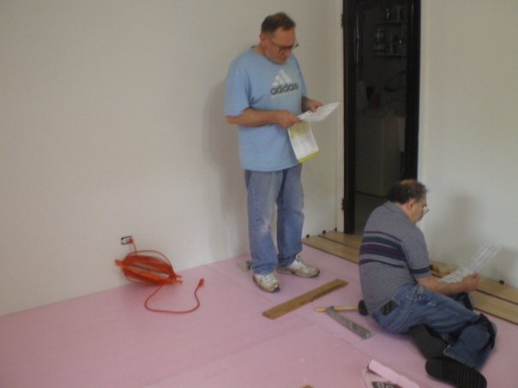



Special Thanks\\
Mark Smart
Skot Wiedmann
Dan Mast
Adam Suchko
Mikhail Karavaev
Kaitlin Minogue
Jane Tu
Tom Engibous (TI)
From top left: University of Illinois, TJ for Califaudio, University of Illinois, Alex Suchko, George Karavaev, Alex Suchko, University of Illinois, Brandon Wade for The Chronicle

Slide 47


Q&A

